Slide 1
Parambiculam Tiger Reserve, Forest & Wildlife Department, Govt. of Kerala, on
02nd and 03rd September, 2019

Slide 2
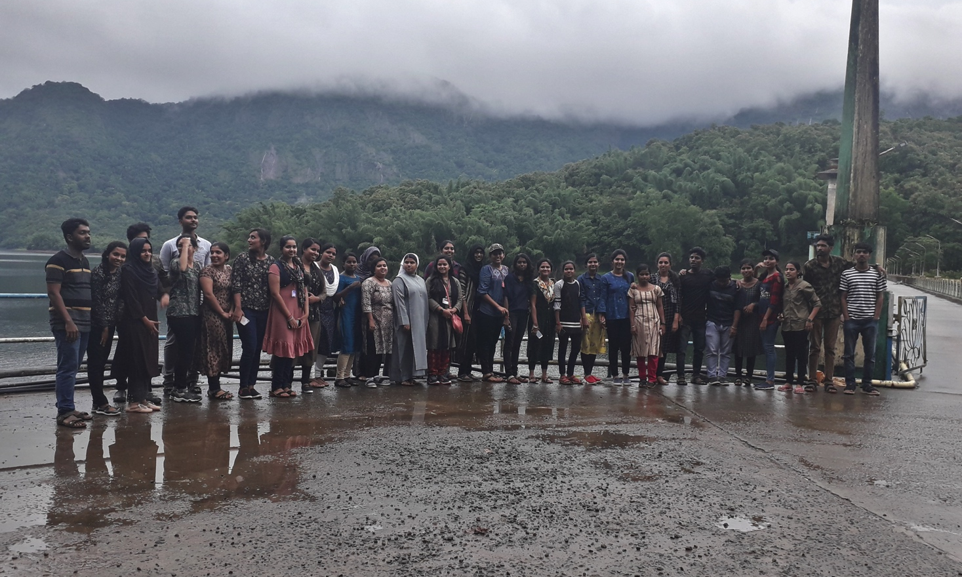

Slide 3
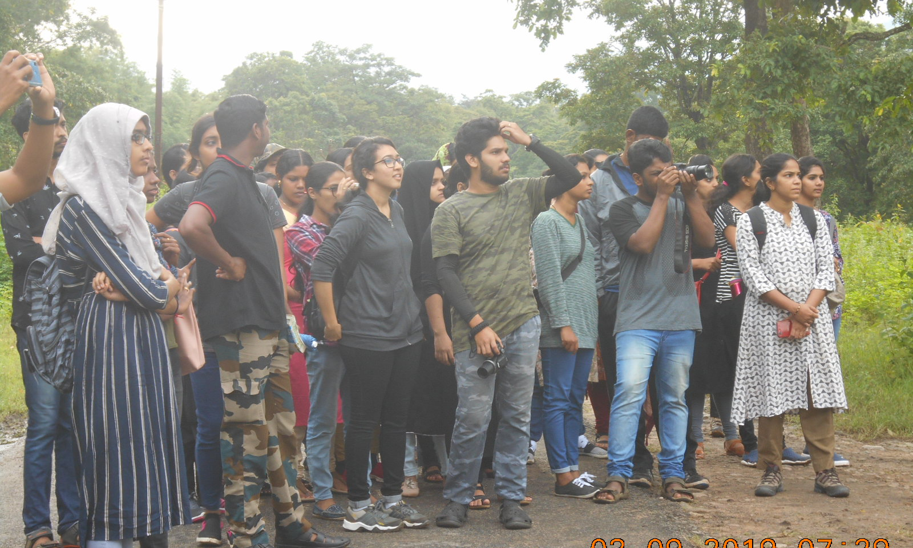

Slide 4
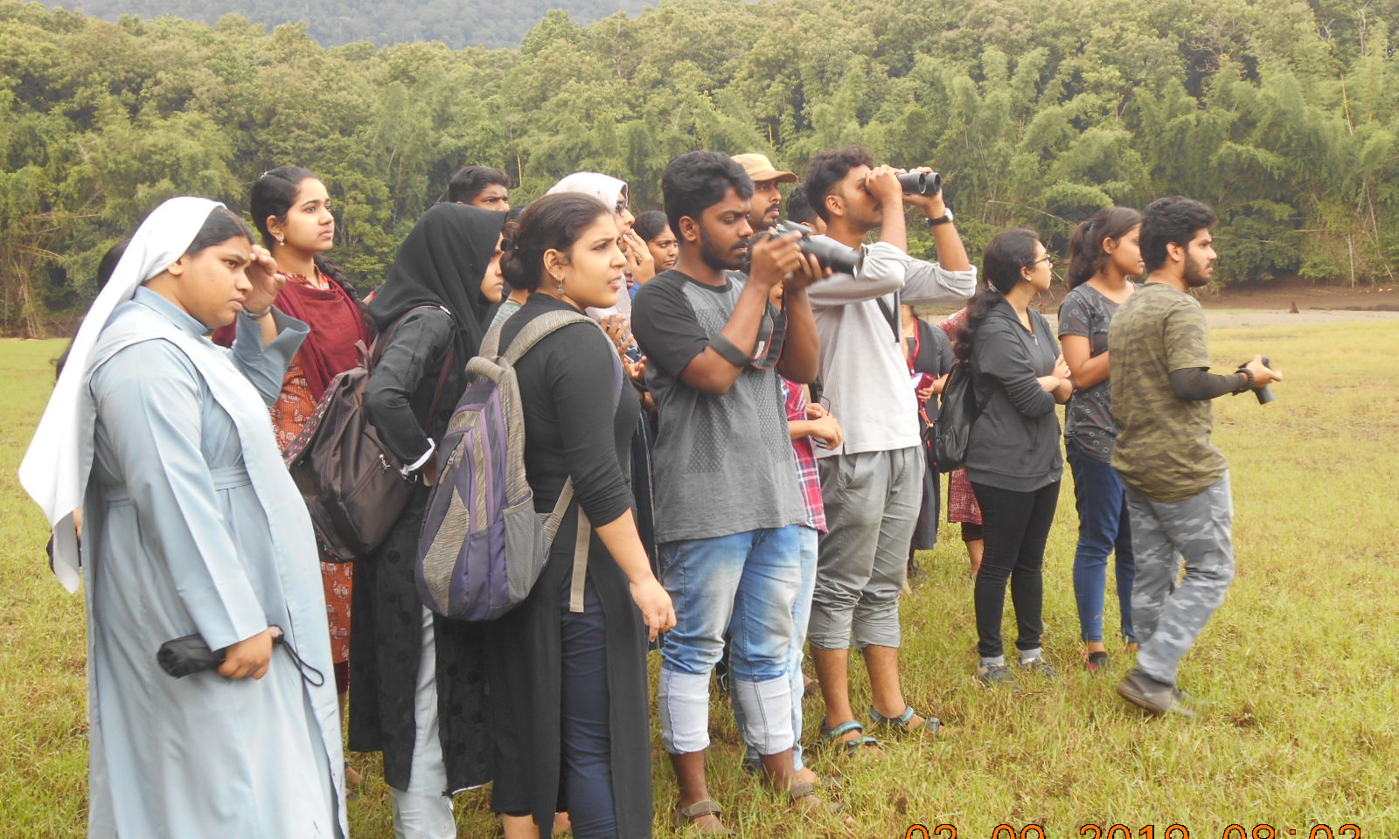

Slide 5
